Slide 1
HAWKES LEARNING
Identifying Types of Sources

Slide 2
Two Ways to Categorize Sources
Primary Sources versus Secondary Sources
&
Popular Sources versus Scholarly Sources
HAWKES LEARNING

Slide 3
Primary and Secondary
vs
Information is not original to source
Original source
HAWKES LEARNING

Slide 4
Primary
Original documents
Speeches
Works of literature
First-hand accounts
Works of art
Research findings
HAWKES LEARNING

Slide 5
Primary
Works of literature
The Giver
Historical documents
Declaration of Independence
HAWKES LEARNING

Slide 6
Primary
Works of literature
The Giver
Historical documents
Declaration of Independence
First-hand accounts
Interview on the radio
Painting
The Mona Lisa
HAWKES LEARNING

Slide 7
Primary and Secondary
Primary
Original source
HAWKES LEARNING

Slide 8
Primary and Secondary
Primary
Secondary
Original source
Reference original source
HAWKES LEARNING

Slide 9
Primary and Secondary
Primary
Secondary
The Giver
An essay that analyzes imagery in The Giver
HAWKES LEARNING

Slide 10
Secondary
Research papers
Websites
Film documentaries
News articles
HAWKES LEARNING

Slide 11
Secondary
Newspaper article about a proposed piece of legislation
HAWKES LEARNING

Slide 12
Secondary
Newspaper article about a proposed piece of legislation
Original piece of legislation
HAWKES LEARNING

Slide 13
Secondary
Authorship
Credibility
HAWKES LEARNING

Slide 14
Popular and Scholarly
Expertise
+
Audience
HAWKES LEARNING

Slide 15
Popular
not an expert
→
general public
HAWKES LEARNING

Slide 16
Popular
Book
The Blindside by Michael Lewis
Magazine
Newsweek
Movie
Mary Poppins
Website
Buzzfeed
HAWKES LEARNING

Slide 17
Scholarly
expert
→
other experts
HAWKES LEARNING

Slide 18
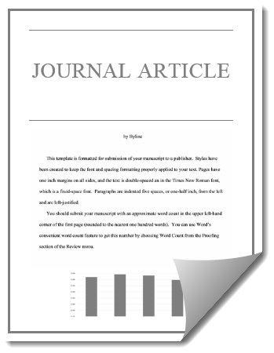
Scholarly
HAWKES LEARNING

Slide 19
Two Ways to Categorize Sources
Primary Sources versus Secondary Sources
&
Popular Sources versus Scholarly Sources
HAWKES LEARNING

Slide 20




HAWKES LEARNING

